Slide 1

INTELLIGENT SNAKE AGENT USING DEEP REINFORCEMENT LEARNING A Comparative Study of Model-Free RL Algorithms
Presented by - Team Chargers:
-Harika Manchineella
-Venkata Uday Kumar Edara
-Vindhya Vaasini Mallapuram

Slide 2
Project Objective:
Develop an AI agent to play Snake game using Deep Reinforcement Learning techniques:
1. Deep Q Network (DQN)
2. Asynchronous Advantage Actor-Critic (A3C)
3. Policy Gradient
4. Proximal Policy Optimization(PPO)
5. Soft Actor-Critic (SAC)
Compare performance metrics (score, efficiency, stability).

Slide 3
What is Reinforcement Learning (RL)?
Reinforcement Learning (RL) is a machine learning approach where an agent learns to make decisions by interacting with an environment to maximize cumulative reward.
Key Components:
Agent – The learner/decision maker (e.g., the Snake)
Environment – The world the agent interacts with (e.g., game grid)
State (s) – Current situation returned by the environment
Action (a) – Choices available to the agent (e.g., turn left/right)
Reward (r) – Feedback from the environment (e.g., +1 for eating food)

Slide 4
Snake Game Environment:
Game Setup:
Classic grid-based board
Snake moves, grows by eating food
Game ends if the snake collides with itself or walls
State Representation:
Snake’s current position and direction
Food location
Proximity to obstacles (walls or body)

Slide 5
Implementation Framework:
Libraries Used:
PyTorch – For building and training neural networks
Pygame – For game development and rendering
NumPy – For numerical operations and data handling
Architecture Overview:
game.py– Implements the game environment, snake behavior, and collision detection
agent.py– Contains the reinforcement learning algorithm and training workflow
model.py– Defines the neural network used to approximate action-values
snake_human_game.py– Allows manual control of the snake for testing and comparison

Slide 6
Training & Evaluation Metrics:
Average Score – Measures consistency across episodes
Maximum Score – Indicates peak performance
Training Time – Evaluates efficiency of each algorithm
Convergence Speed – How quickly the model stabilizes
Stability – Variance in scores over time
Visualization:
Plot: Episodes vs. Score
Compare performance trends across DQN, A3C, and Policy Gradient

Slide 7
Deep Q-Network (DQN):
Methodology:
Combines Q-Learning with deep neural networks to handle high-dimensional state spaces.
Uses a replay buffer to store experiences and reduce correlation between samples.
Employs a target network for stable training.
Key Features:
Off-policy algorithm (learns from past experiences).
Uses ε-greedy exploration for balancing exploration-exploitation.
Suitable for discrete action spaces (e.g., Atari games).
Challenges:
High sample complexity.
Not suitable for continuous action spaces.

Slide 8
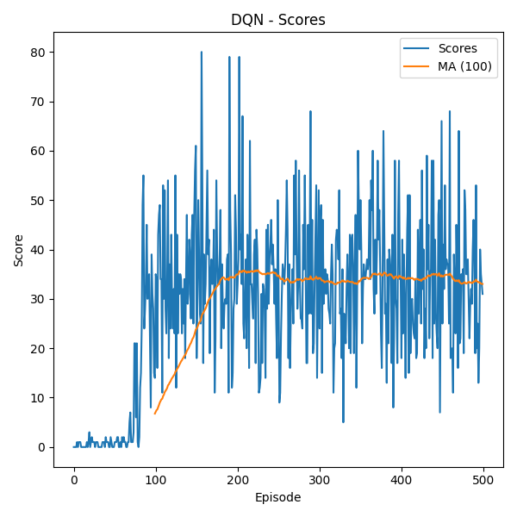
Performance Metrics for DQN:
Metric | Value
Max Score | 78
Average Score | 29.2
Training Time (min) | 33.32 mins
Convergence Episode | 234
Average Episode Length | 654.17 steps
Score Standard Deviation | 17.65

Slide 9
Dueling DQN
Methodology:
Combines Q-Learning with deep neural networks to handle high-dimensional state spaces.
Uses a replay buffer to store experiences and reduce correlation between samples.
Employs a target network for stable training.
Key Features:
Reduces overoptimistic Q-values by separating action selection and evaluation.
Uses the same architecture as DQN (easy to implement).
Compatible with discrete action spaces (e.g., Snake game).
Challenges:
Still requires large replay buffers (sample inefficiency).
Limited to discrete actions like DQN

Slide 10
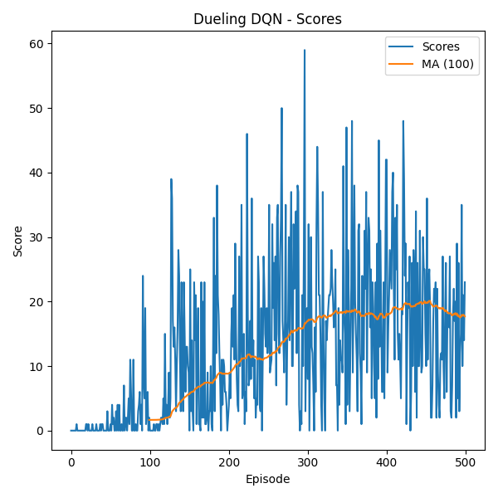
Performance Metrics for Deuling DQN:
Metric | Value
Max Score | 59
Average Score | 12.586
Training Time (min) | 41.88 mins
Convergence Episode | 330
Average Episode Length | 493.92 steps
Score Standard Deviation | 11.92

Slide 11
A3C: Asynchronous Advantage Actor-Critic
Methodology:
An on-policy RL algorithm combining Policy Gradient (Actor) and Value Function (Critic).
Uses parallel agents (asynchronous updates) for faster, more stable training.
Estimates the advantage function (A = Q - V) to reduce variance.
Key Features:
Parallel training → Faster convergence.
Better sample efficiency than pure Policy Gradients.
Works in both discrete & continuous action spaces.
Challenges:
Hyperparameter-sensitive.
Requires careful tuning for stability.

Slide 12
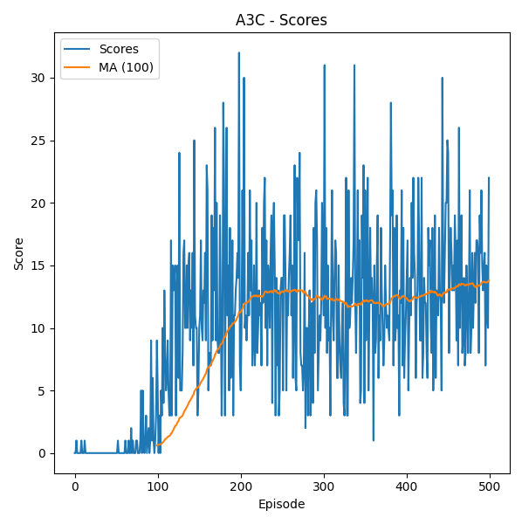
Performance Metrics for A3C:
Metric | Value
Max Score | 32
Average Score | 10.066
Training Time (min) | 17.13 minutes
Convergence Episode | 213
Average Episode Length | 275.38 steps
Score Standard Deviation | 7.13

Slide 13
Double DQN
Methodology:
Splits the Q-network into two streams:
1. State value stream (how good the state is).
2. Advantage stream (how much better an action is than others).
Combines them to estimate Q-values more robustly.
Challenges:
Slightly more complex architecture than DQN.
Requires careful hyperparameter tuning.
Limited to discrete actions like DQN

Slide 14
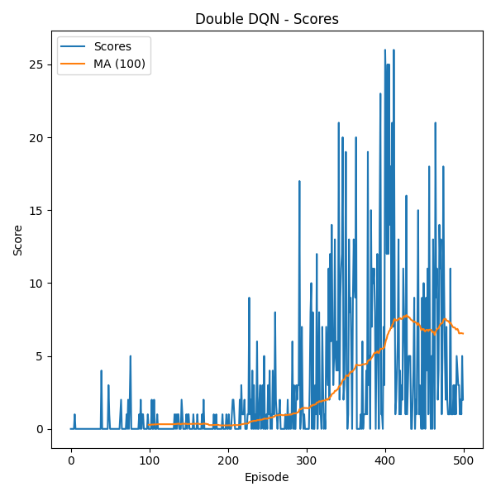
Performance Metrics for Double DQN:
Metric | Value
Max Score | 26
Average Score | 2.816
Training Time (min) | 23.94 mins
Convergence Episode | 500
Average Episode Length | 401.34 steps
Score Standard Deviation | 4.92

Slide 15
Soft Actor-Critic (SAC)
Methodology:
An off-policy actor-critic method that maximizes entropy (encourages exploration).
Combines policy gradient and Q-learning for stability.
Uses two Q-networks + a value function to reduce overestimation bias.
Key Features:
Sample-efficient (off-policy + replay buffer).
Automatically balances exploration-exploitation via entropy.
Works in continuous action spaces.
Challenges:
More complex than PPO.

Slide 16
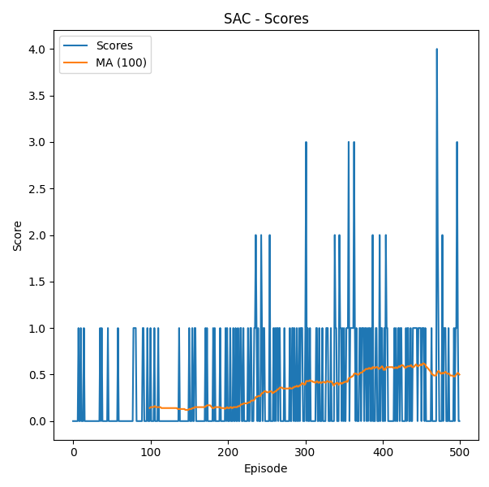
Performance Metrics for Soft Actor Critic:
Metric | Value
Max Score | 4
Average Score | 0.354
Training Time (min) | 12.75 minutes
Convergence Episode | 500
Average Episode Length | 242.94 steps
Score Standard Deviation | 0.584

Slide 17
Proximal Policy Optimization
Methodology:
Uses a clipped objective to avoid large policy updates.
More stable than vanilla Policy Gradient.
Key Features:
Simple, efficient, and widely used.
work well in continuous control tasks.
Challenges:
PPO may converge to suboptimal policies.

Slide 18
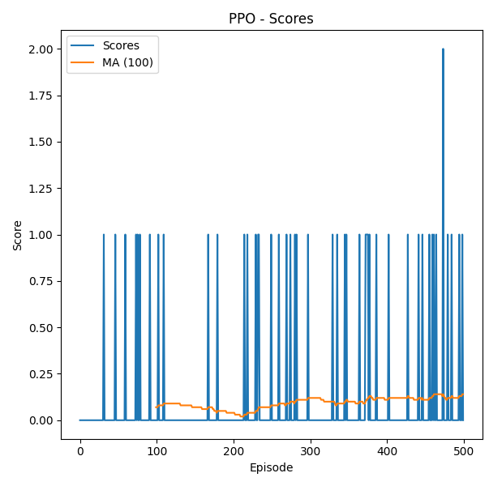
Performance Metrics for Proximal Policy Optimization:
Metric | Value
Max Score | 1
Average Score | 0.038
Training Time (min) | 19.39 minutes
Convergence Episode | 500
Average Episode Length | 365.96 steps
Score Standard Deviation | 0.191

Slide 19
Policy Gradient Methods:
Methodology:
Directly optimizes the policy (π) using gradient ascent.
Maximizes expected return by adjusting policy parameters.
Common variants: REINFORCE, PPO, TRPO.
Key Features:
Can learn stochastic policies..
No need for a value function (in pure form).
Challenges:
High variance in gradient estimates.
Sample inefficient (requires many episodes).

Slide 20
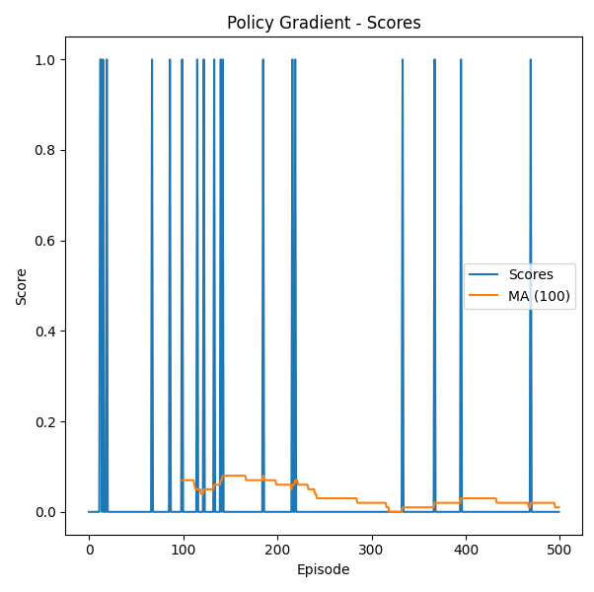
Performance Metrics for Policy Gradient:
Metric | Value
Max Score | 1
Average Score | 0.038
Training Time (min) | 19.39 minutes
Convergence Episode | 500
Average Episode Length | 365.96 steps
Score Standard Deviation | 0.191

Slide 21
Algorithm Comparisons
Algorithm | Max Score | Average Score | Training Time (min) | Convergence Episode | Average Episode Length | Score Std Dev
DQN | 78 | 29.2 | 33.32 | 234 | 654.17 | 17.65
Dueling DQN | 59 | 12.586 | 41.88 | 330 | 493.92 | 11.92
A3C | 32 | 10.066 | 17.13 | 213 | 275.38 | 7.13
Double DQN | 26 | 2.816 | 23.94 | 500 | 401.34 | 4.92
SAC | 4 | 0.354 | 12.75 | 500 | 242.94 | 0.58
PPO | 2 | 0.096 | 7.35 | 500 | 121.57 | 0.3
Policy Gradient | 1 | 0.038 | 19.39 | 500 | 365.96 | 0.19

Slide 22
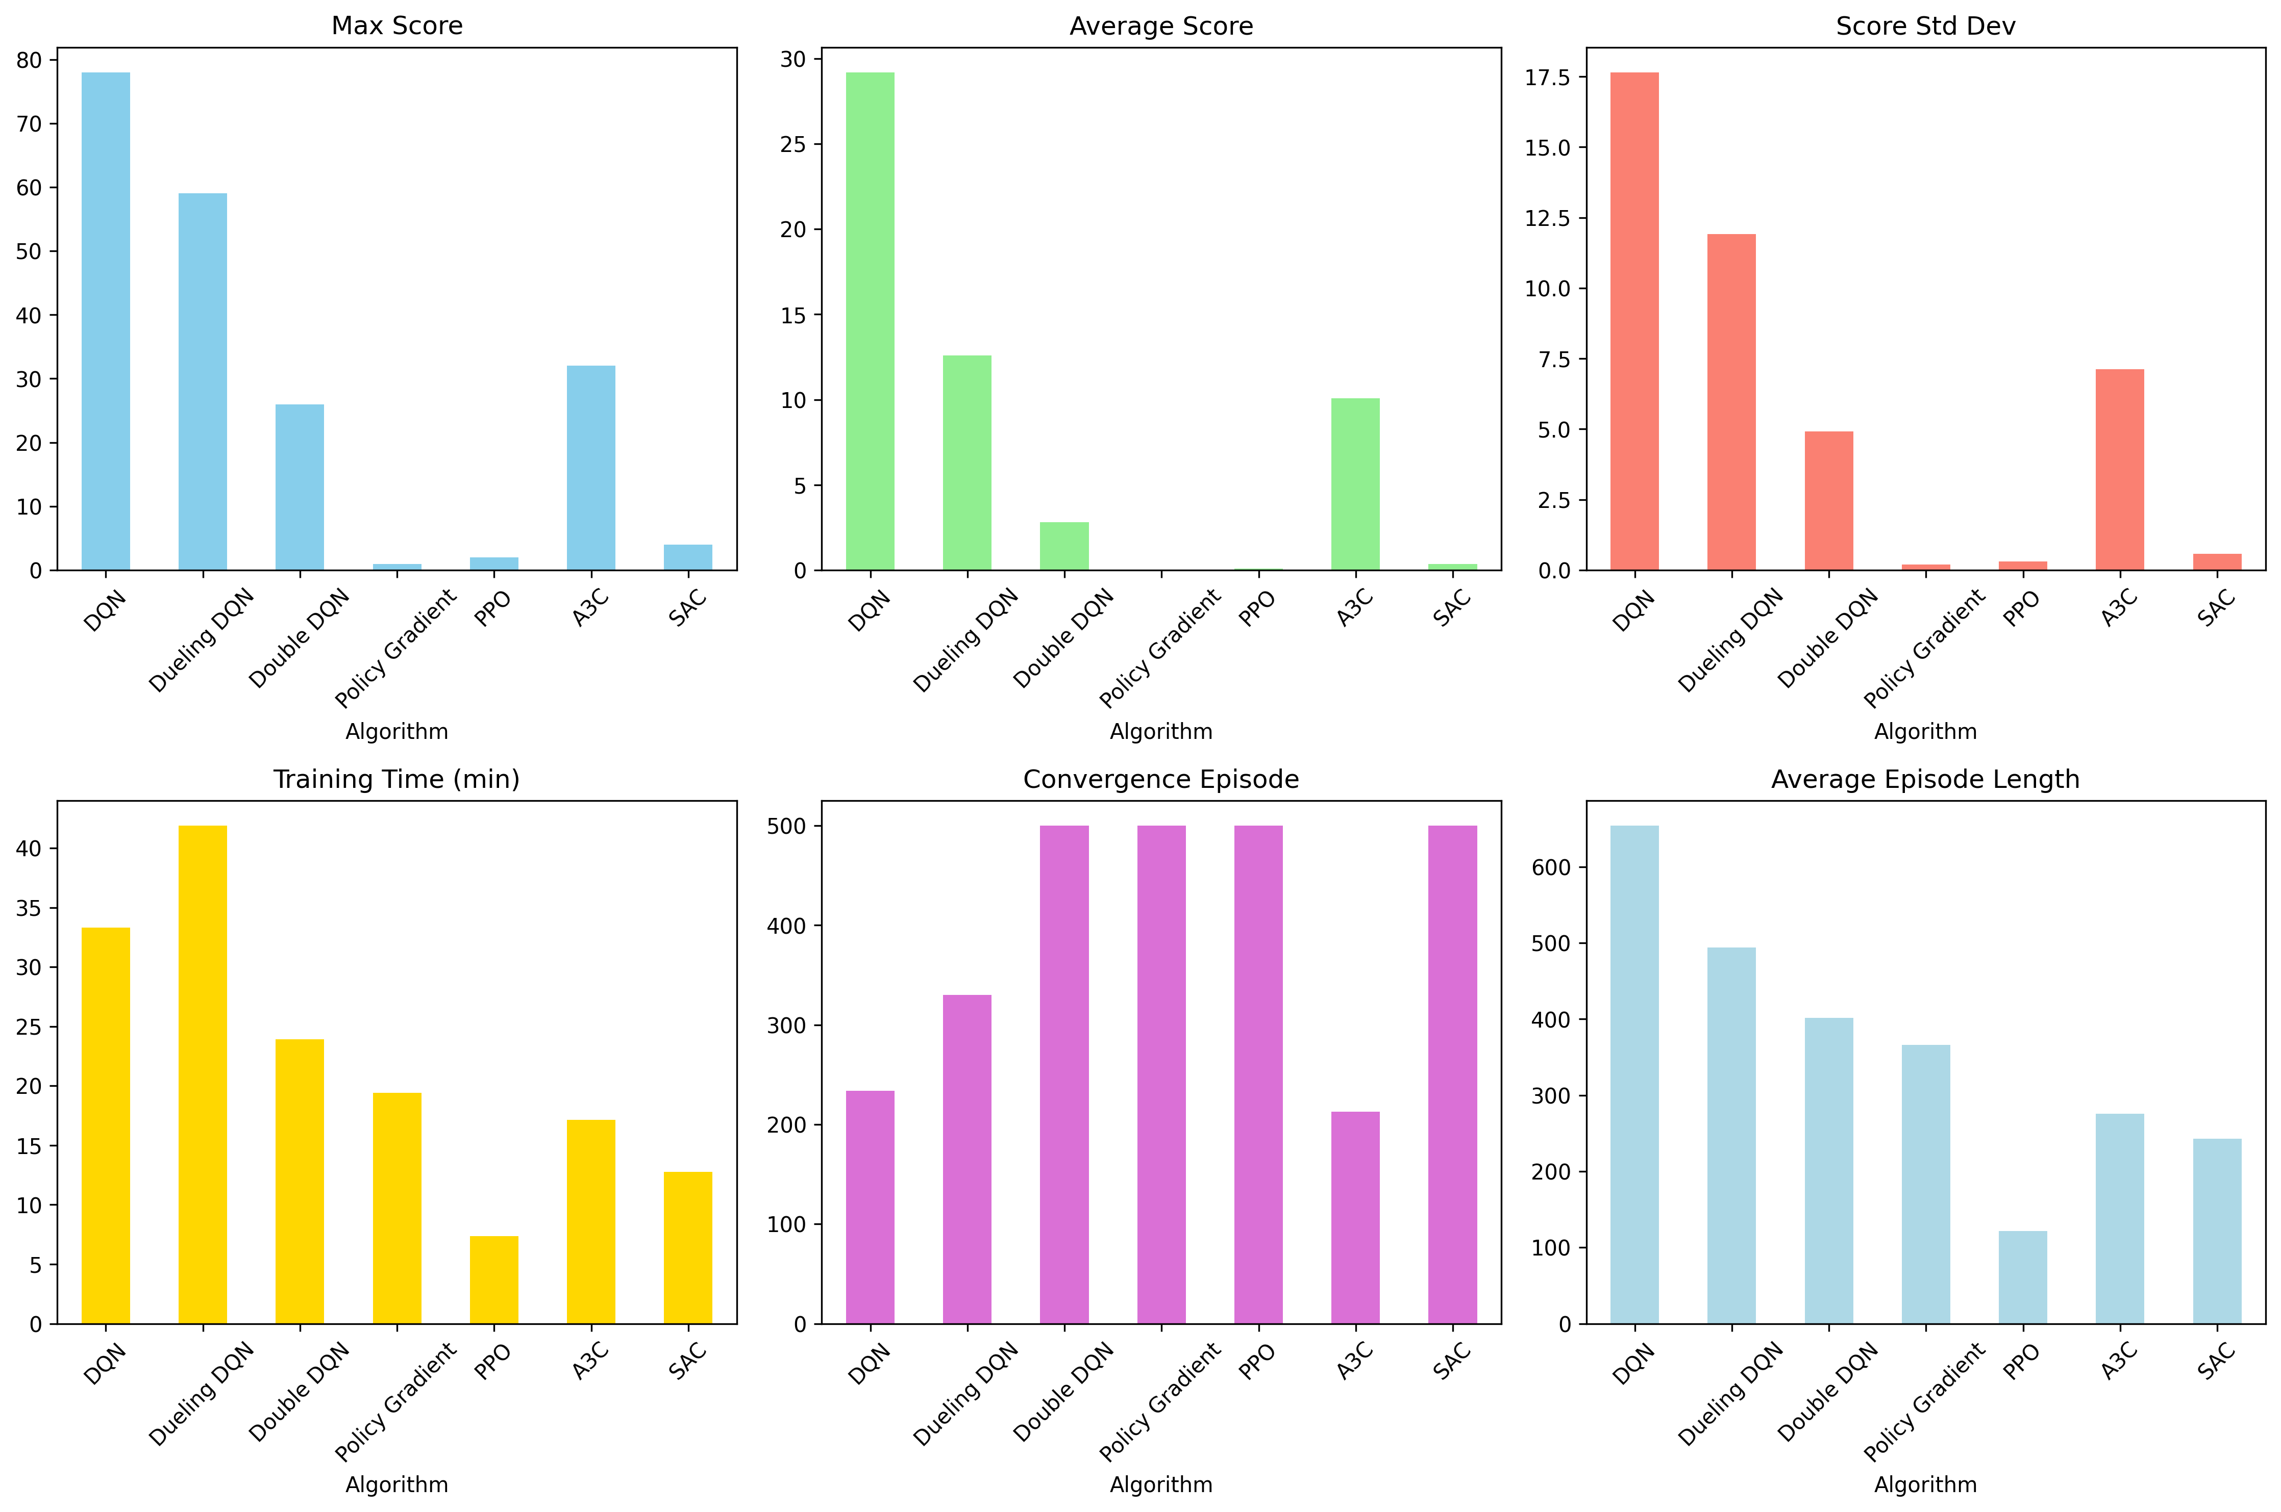

Slide 23
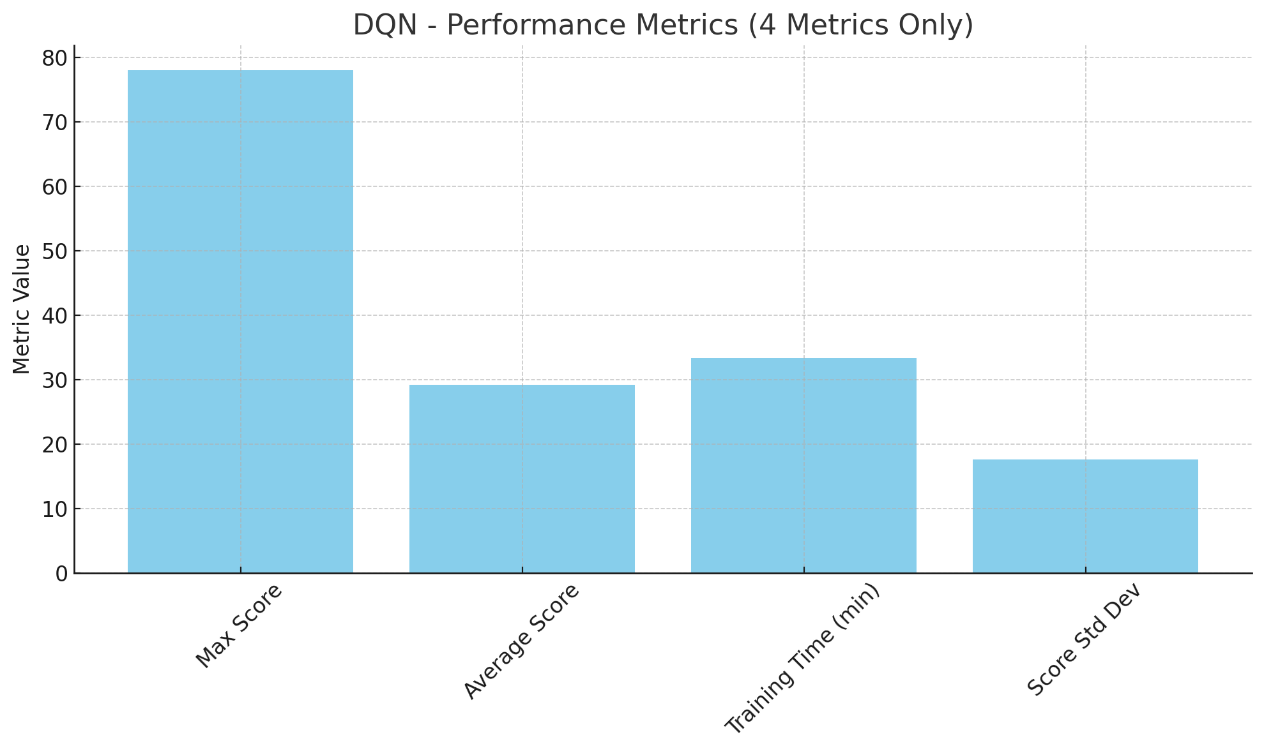
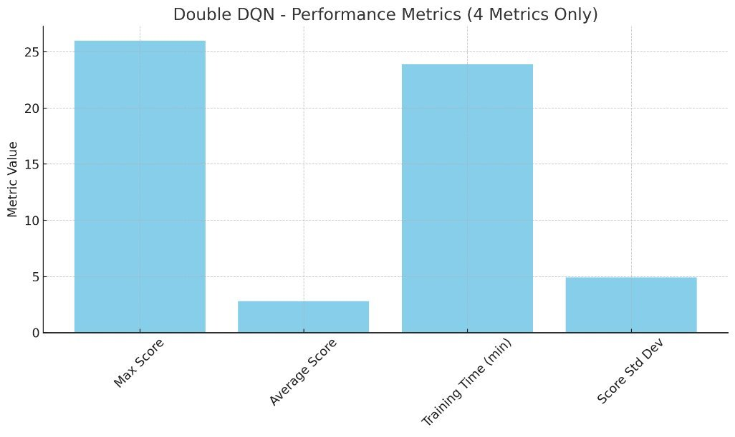
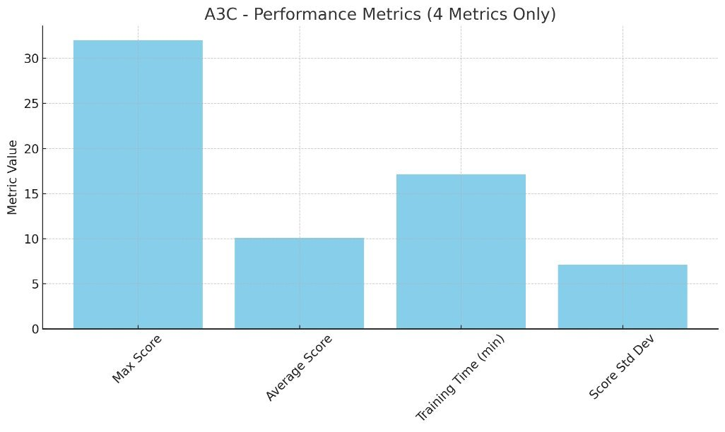
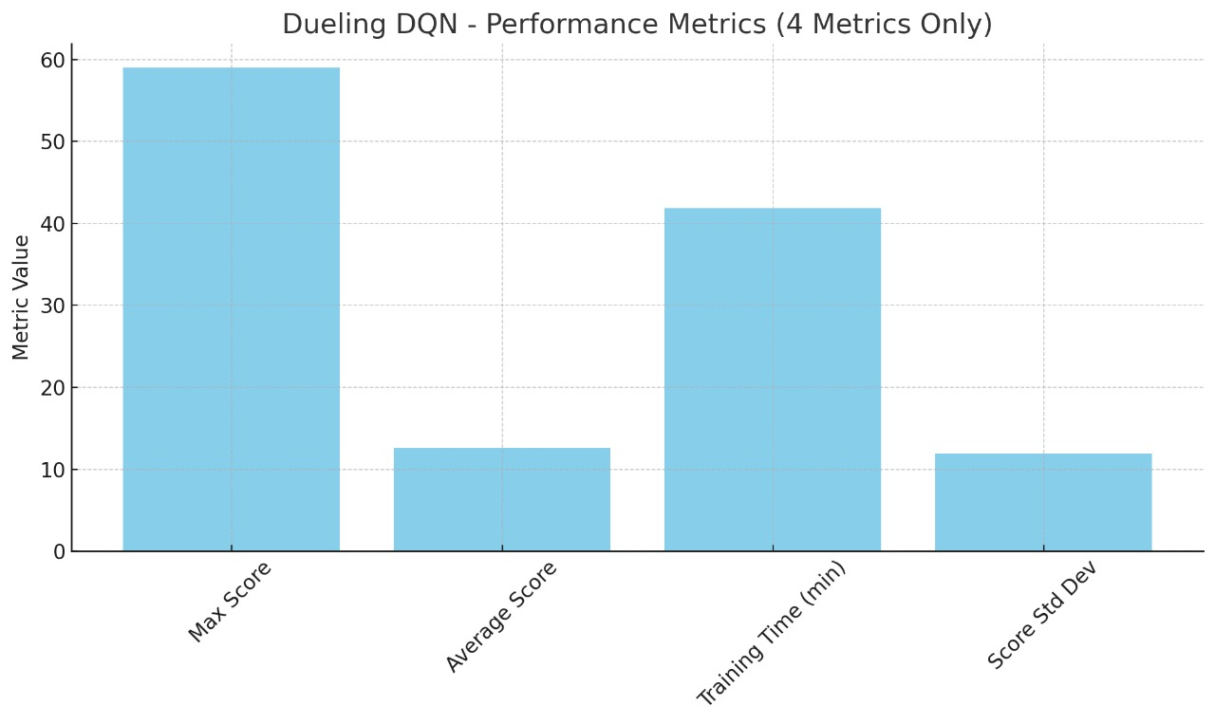

Slide 24
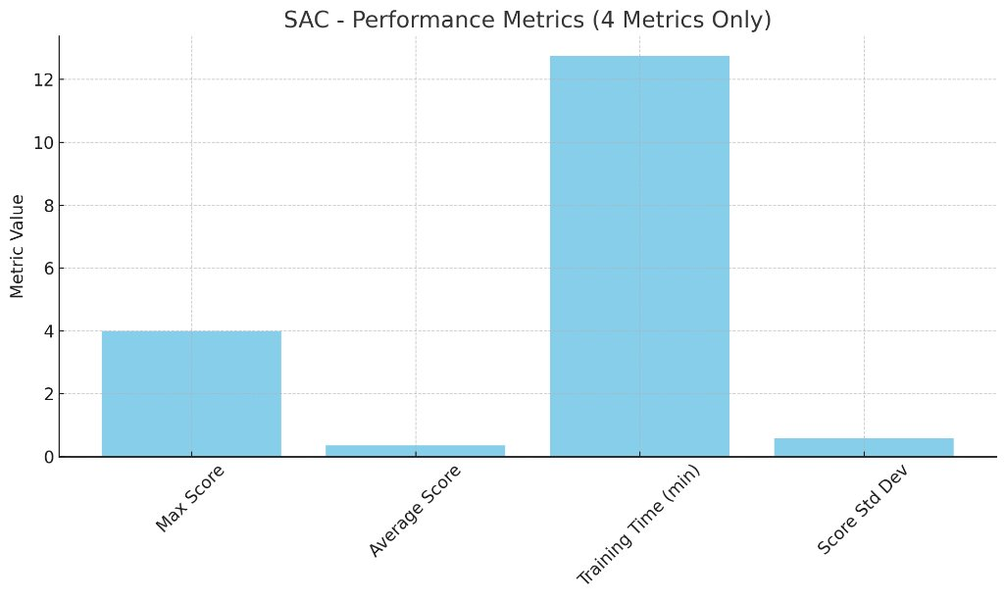
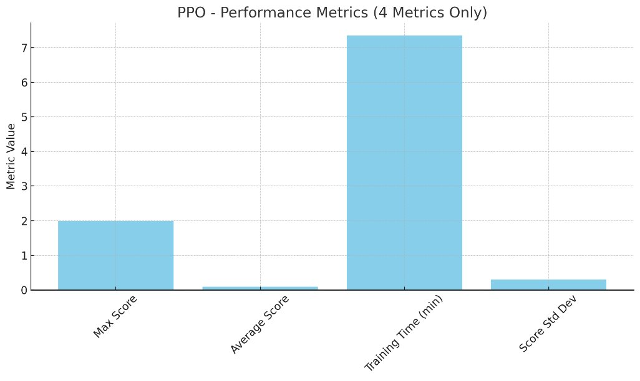
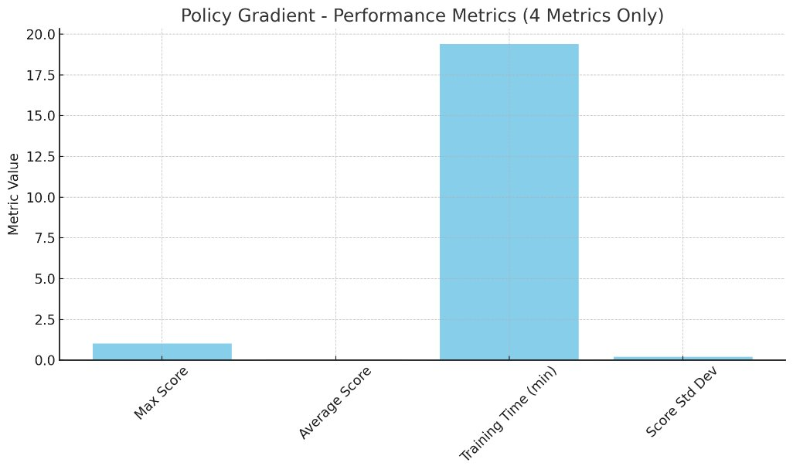

Slide 25
Conclusion:
Best Performing Algorithm: DQN
Highest Max Score (78) and Average Score (29.2)
Drawback: High Score Std Dev (17.65) → unstable
Most Balanced: A3C
Fastest convergence (213 episodes)
Moderate score (Avg: 10.06)
Efficient training (17.13 min)
Lower variance than DQN → more stable

Slide 26
Dueling DQN
Good Max Score (59) and improved stability (Std Dev: 11.92)
Poor Average Score and longest training time (41.88 min)
Underperformers
Double DQN: Stable, but poor scores and late convergence
SAC, PPO, Policy Gradient:
Very low scores (Avg < 0.4)
Did not converge within 500 episodes
Best in stability but failed to learn meaningful policy

Slide 27
References:
[1] D. Ray, A. Ghosh, M. Ojha, and K. P. Singh, "Deep Q-Snake: An Intelligent Agent Mastering the Snake Game with Deep Reinforcement Learning," 2024 IEEE Region 10 Conference (TENCON), 2024, pp. 1465–1472, doi: 10.1109/TENCON61640.2024.10903025.
[2] A. del Rio, D. Jimenez, and J. Serrano, "Comparative Analysis of A3C and PPO Algorithms in Reinforcement Learning: A Survey on General Environments," IEEE Access, vol. 12, pp. 146795–146812, Oct. 2024, doi: 10.1109/ACCESS.2024.3472473.
[3] J. Wang, D. Xue, J. Zhao, W. Zhou, and H. Li, "Mastering the Game of 3v3 Snakes with Rule-Enhanced Multi-Agent Reinforcement Learning," 2022 IEEE Conference on Games (CoG), Beijing, China, pp. 229–236, Aug. 2022, doi: 10.1109/CoG51982.2022.9893608.
[4] https://github.com/patrickloeber/snake-ai-pytorch

